Slide 1
Perception & Visualization

Slide 2




data
knowledge
(analysis—stats, ML, etc.) (visualization) (perception) (cognition)

Slide 3
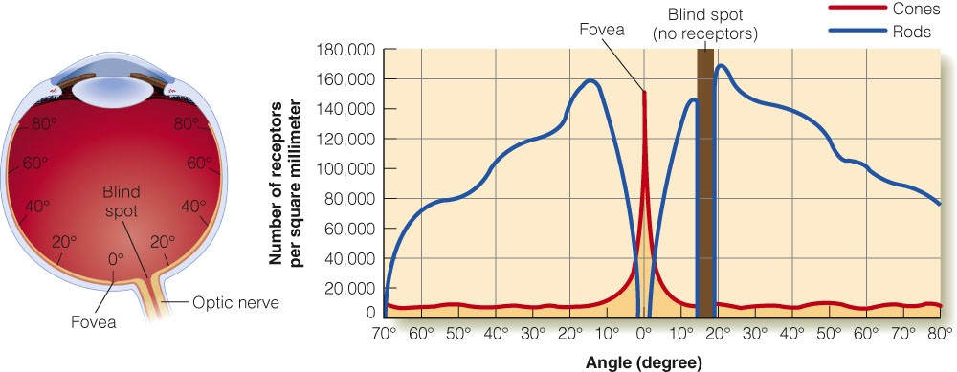
E. B. Goldstein “Sensation and Perception” (Adapted from Lindsay & Norman, 1977)

Slide 4
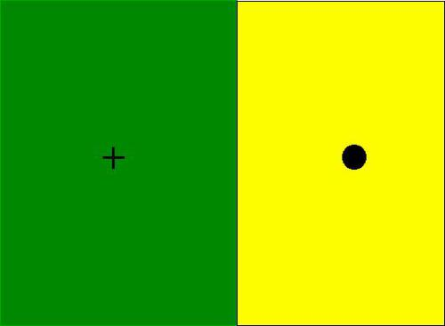
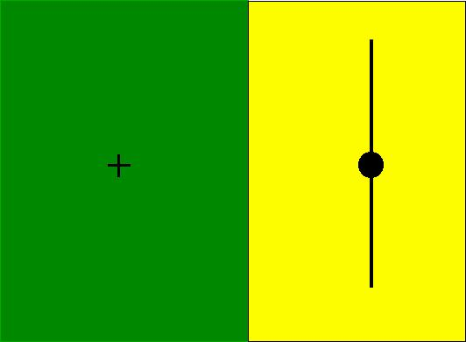
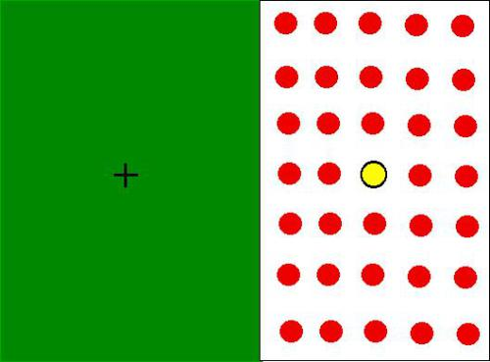
Blind Spot
Close one eye, stair at +, move around until the image changes

Slide 5
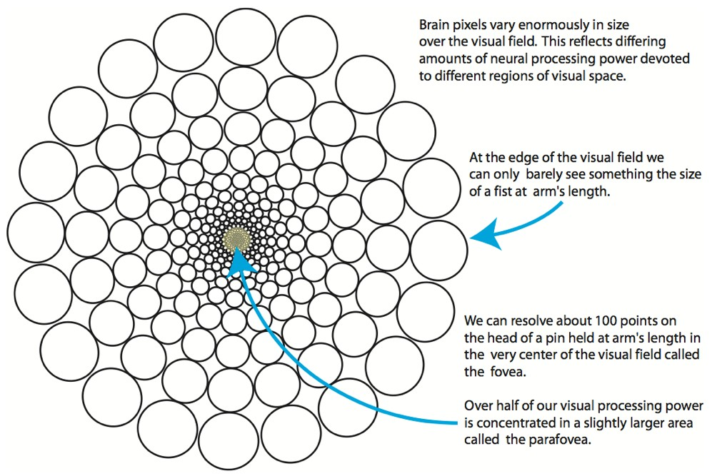
Ware 2010

Slide 6
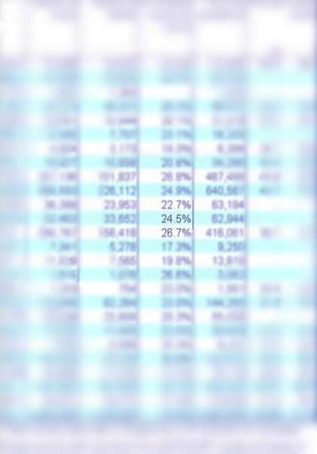
Foviation
Foveation is relatively easy to see. The key to recognizing the phenomenon is to stair at a single word on the printed page. Then, without moving your gaze, note the blurriness of the surrounding text.
C.Ware,“Visual Thinking for Design”

Slide 7
Takeaway
Our vision at any given moment is relatively limited. Our brain “fills in the missing pieces” using a variety of evolved tools.
Be careful placing too much data on the screen. Crisp and clear visualizations will result in the best interpretation.

Slide 8
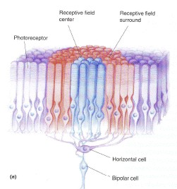
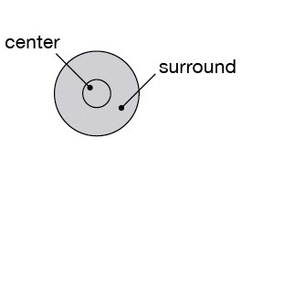

receptive field
light hits rods and cones
100M rods and cones
1M ganglion cells
single neuron fires
Bear, Connors, Paradiso,“Neuroscience”

Slide 9
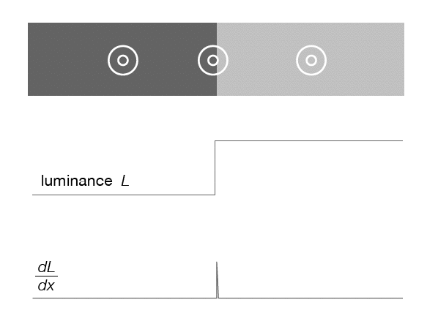
low activity
center and surrounds cancel
activity increased
or decreased at edges

Slide 10
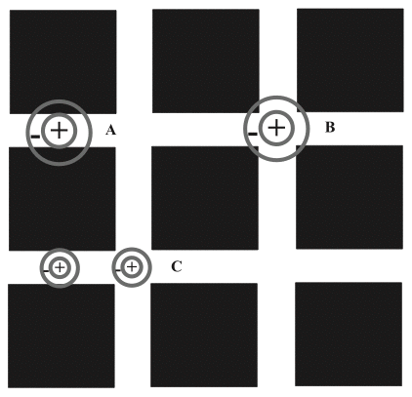
Hermann grid effect
Annie Prud’homme-Généreux

Slide 11
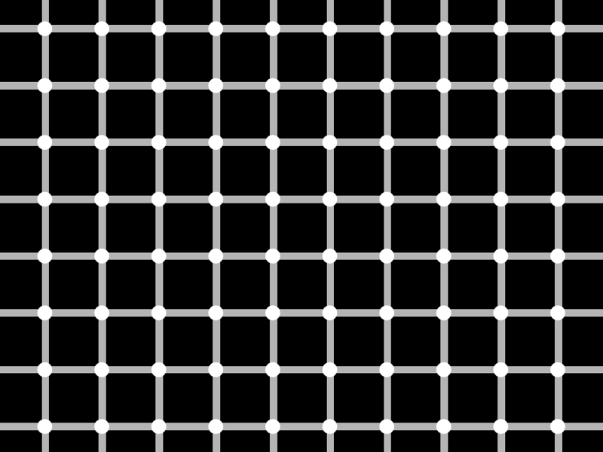

Slide 12
Cornsweet Illusion

Slide 13
Cornsweet Illusion

Slide 14
Cornsweet Illusion
Actual Luminance
Perceived Luminance

Slide 15
Takeaway
Our visual system is attracted to edges and is sensitive to differences, not absolute values.
Maximize the contrast with the background if the outlines of shapes are important.

Slide 16
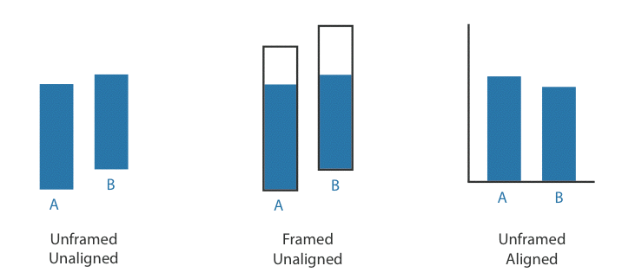
WEBER’S LAW
we judge based on relative, not absolute, differences

Slide 17
AXIS OF ALIGNMENT

Slide 18
AXIS OF ALIGNMENT

Slide 19
simultaneous contrast

Slide 20
SIMULTANEOUS CONTRAST

Slide 21
SIMULTANEOUS CONTRAST

Slide 22
SIMULTANEOUS CONTRAST

Slide 23
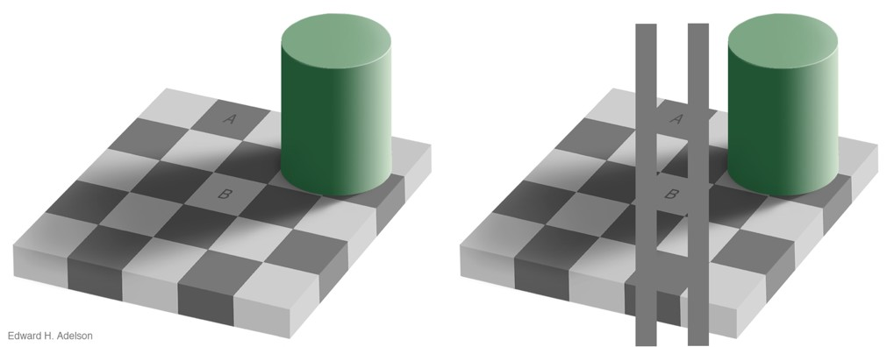
SIMULTANEOUS CONTRAST
http://persci.mit.edu/_media/gallery/checkershadow_double_full.jpg

Slide 24
Takeaway
We have a strong propensity to assume our judgments are absolute, when in fact they are generally relative to the local context.
Do your best to not place data in difficult contexts. Choose position and orientation of objects carefully.

Slide 25
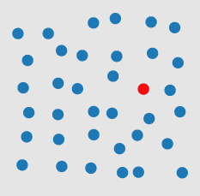

Pick the outlier
Healy 2007

Slide 26
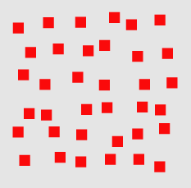
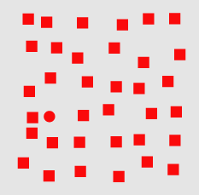
Pick the outlier
Healy 2007

Slide 27
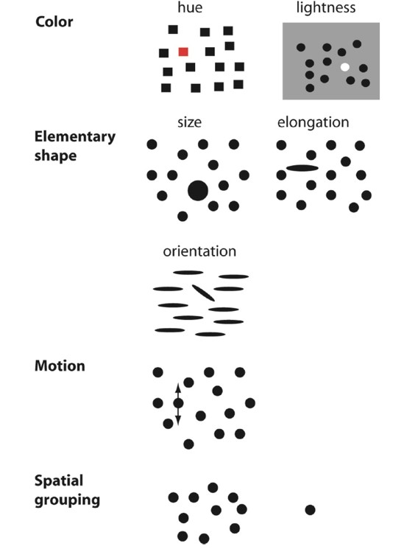
BASIC POPOUT CHANNELS
Ware 2008

Slide 28
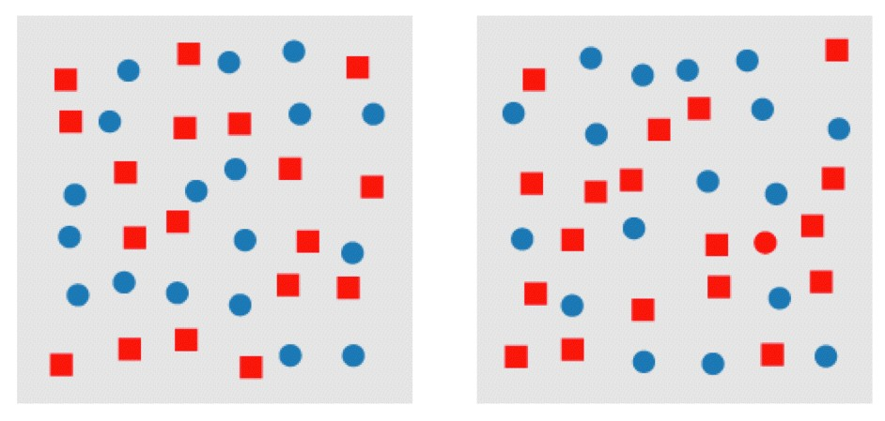
Pick the outlier
Healy 2007

Slide 29
CONJUNCTION (or, why to use a single channel at a time)
Healy 2007

Slide 30
Takeaway
We can easily see objects that are different in color and shape, or that are in motion.
Use color and shape sparingly to make the important information pop out.

Slide 31
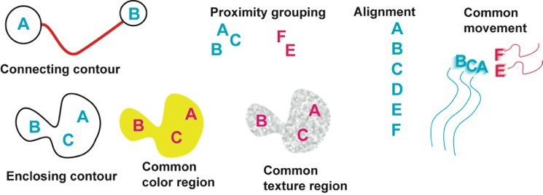
Gestalt principles
German: “Gestalt” = form
patterns transcend the visual stimuli that produced them

Slide 32

similarity
Bang Wong, “Gestalt Principles, 1”, Nature Methods

Slide 33
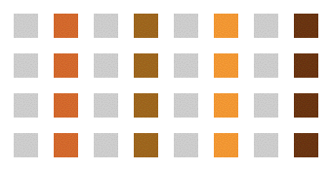
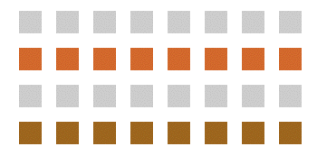
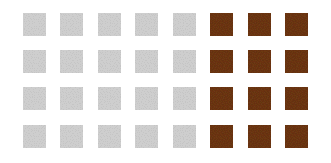
similarity
Andy Rutledge, “Gestalt Principles of Perception”

Slide 34
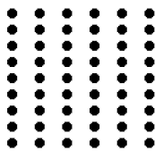
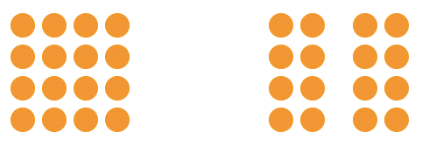

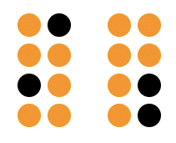
proximity
Andy Rutledge, “Gestalt Principles of Perception”

Slide 35
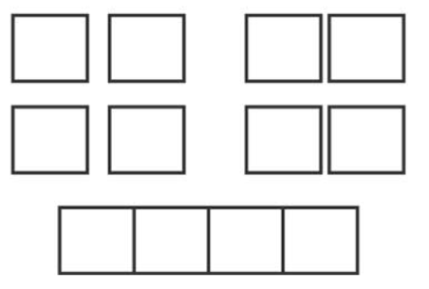
proximity
Bang Wong, “Gestalt Principles, 1”, Nature Methods

Slide 36
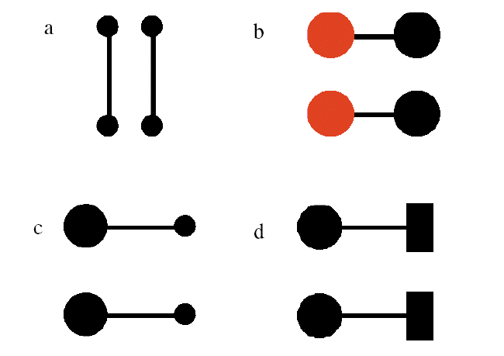
connectedness
Ware, “Information Visualization”

Slide 37
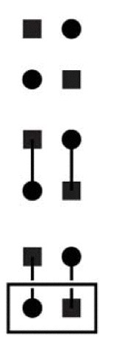
grouping
Similarity
Connection
Enclosure
Bang Wong, “Gestalt Principles, 1”, Nature Methods

Slide 38
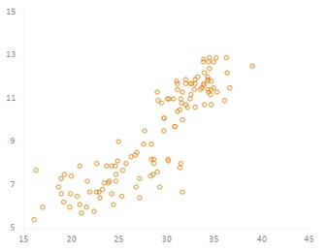
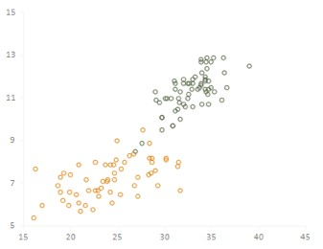
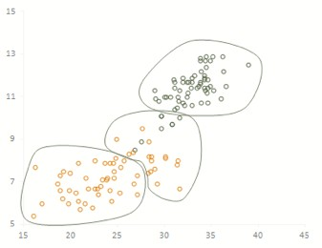
grouping
proximity
similarity
enclosure
Jorge Camoes

Slide 39
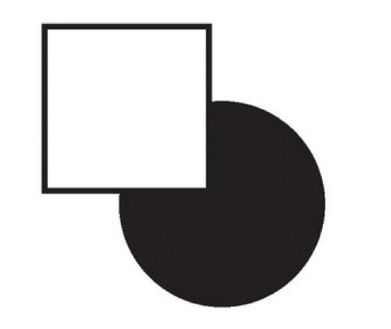
continuity
Bang Wong, “Gestalt Principles, 1”, Nature Methods

Slide 40
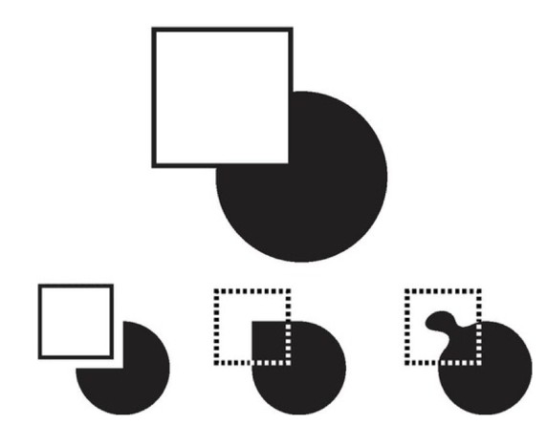
continuity
Bang Wong, “Gestalt Principles, 1”, Nature Methods

Slide 41


closure
Bang Wong, “Gestalt Principles, 1”, Nature Methods

Slide 42
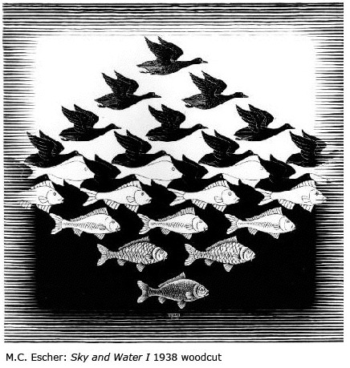

figure / ground
Bang Wong, “Gestalt Principles, 1”, Nature Methods

Slide 43
common fate
Andy Rutledge, “Gestalt Principles of Perception”

Slide 44
Gestalt principles
similarity: things that look like each other (size, color, shape) are related
proximity: things that are visually close to each other are related
connection: things that are visually connected are related
continuity: we complete hidden objects into simple, familiar shapes
closure: we see incomplete shapes as complete
figure / ground: elements are perceived as either figures or background
common fate: elements with the same moving direction are perceived as a unit

Slide 45
Takeaways
Gestalt principles give us a conceptual understanding of the way our mind converts shapes into structured thought.
Using the Gestalt principles wisely will lead improve performance in interpretation of visualizations. Poor use may cause users to see things that aren’t there…

Slide 46
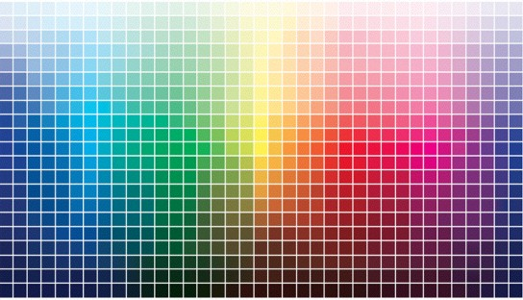
Color

Slide 47
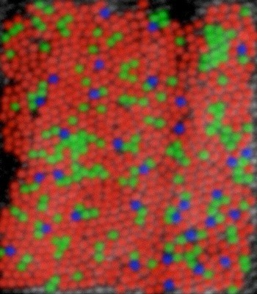
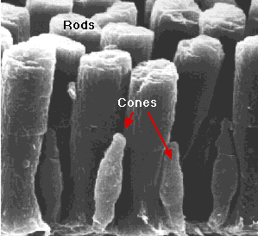
120 million rods
5-6 million cones
Wandell,“Foundations of Vision” (left) David R.Williams, Univ. of Rochester (right)

Slide 48
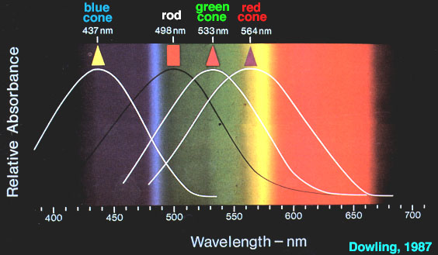
Cone Response

Slide 49

ADDITIVE COLOR
(like we see in light)
primary: RGB
secondary: CMY
very common color space
not perceptually uniform
actual color is device-dependent

Slide 50
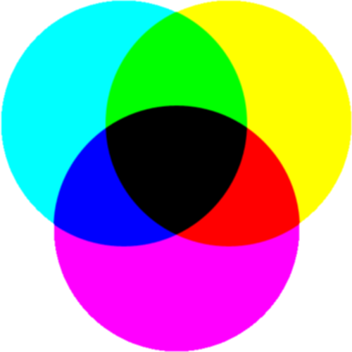
SUBTRACTIVE COLOR
(used in print ink)
primary: CMY
secondary: RGB
approx black = C+M+Y
true black = C+M+Y+K
actual color is device-dependent

Slide 51
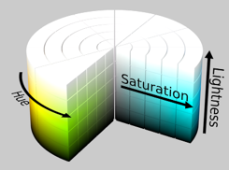
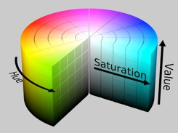
HSV [B, L, I] (additive)
Hue, Saturation, [Value, Brightness, Lightness, Intensity]
polar coordinate representations of RGB space
conical or cylindrical shaped space
more intuitive than RGB for color tuning
hue: what people think of as color
saturation: amount of white mixed in
luminance: amount of black mixed in
lightness vs value (or brightness)
intensity, in computer vision applications

Slide 52
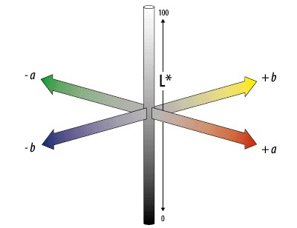
CIE LAB/LUV
mathematically defined & perceptually based to include all perceivable colors
a: red to green
b: yellow to blue
L*: lightness (black to white)

Slide 53
COLOR BLINDNESS
deficiency in color vision
typically caused by faulty cone development
found more in men than women
photopigment genes carried in x-chromosome
5-8% of (European origin) men and 0.5% of women

Slide 54
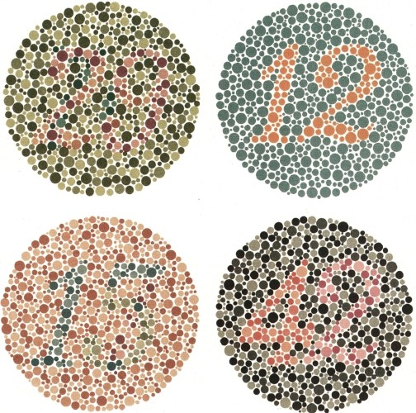

Slide 55
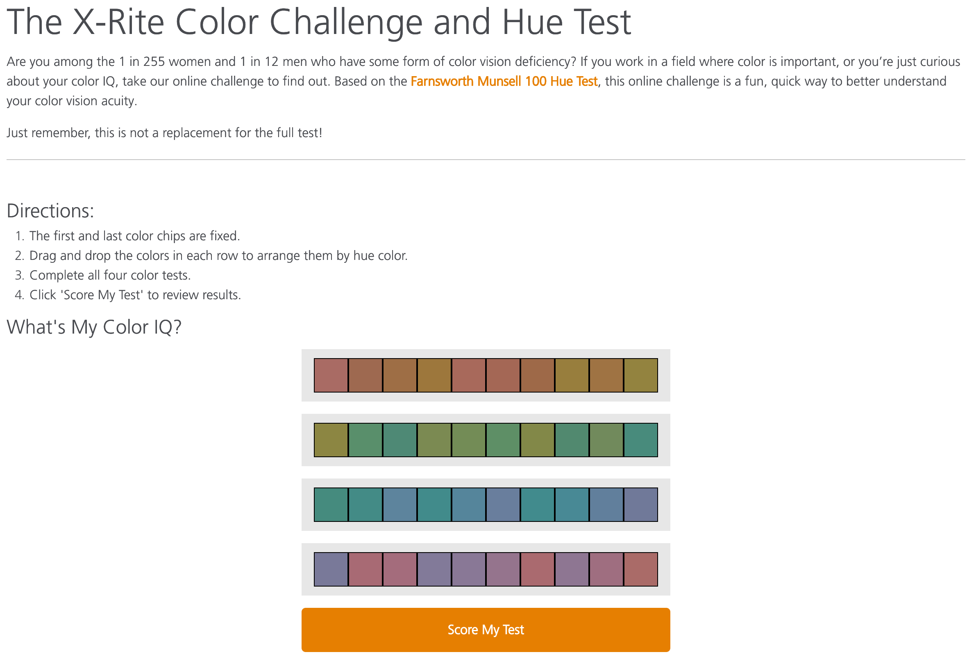

Slide 56
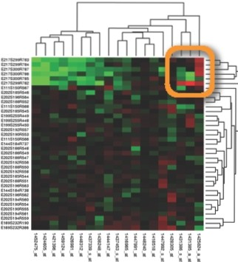
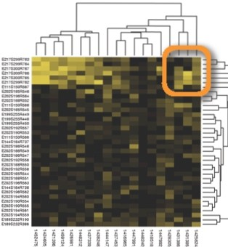
................. .
• •
• •••

Slide 57
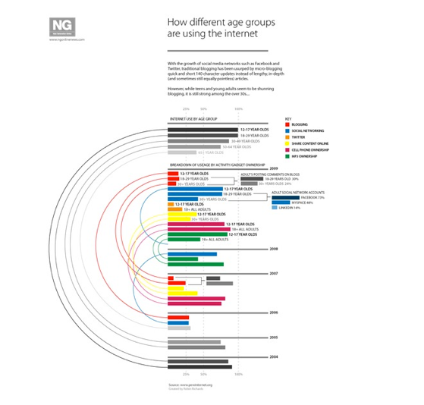
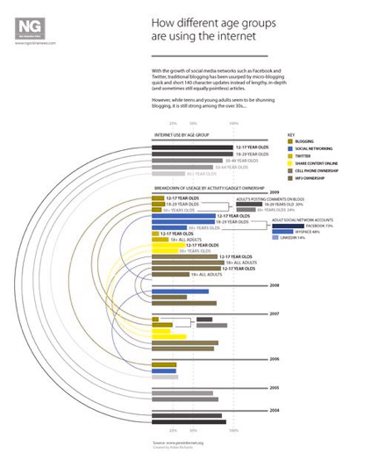

Slide 58
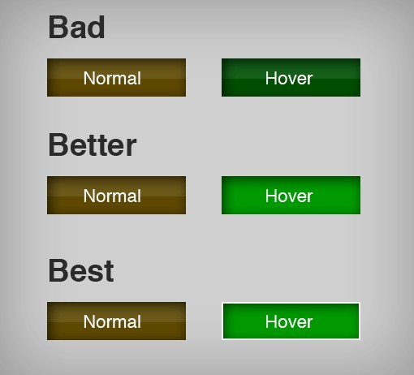
Takeaway
Even if you aren’t colorblind, someone you’re working with could be
Be sure to design with colorblindness in mind by:
varying hue, saturation, brightness
using monochrome color schemes
using cues besides/in addition to color
software solution, vischeck (http://www.vischeck.com)

Slide 59
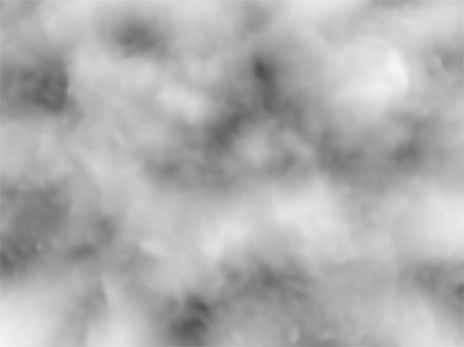

Contrast Sensitivity
C.Ware, “Visual Thinking for Design”

Slide 60
Takeaway
We have higher contrast sensitivity in the luminance than in the chrominance channel. Show preference to luminance for encoding detail.

Slide 61

Color Relativity

Slide 62
Color Relativity

Slide 63
Color Relativity

Slide 64

Color Relativity

Slide 65

Color Relativity

Slide 66


Slide 67


Color Relativity

Slide 68
Takeaway
We have a strong propensity to assume our judgments of color are absolute, when in fact they are extremely relativistic.
Do your best to not place data in difficult contexts. Use color sparingly.

Slide 69


luminance contrast

Slide 70

size & color
“the smaller the mark, the less distinguishable are the colors”
-Jacques Bertin

Slide 71
guidelines
color is a relative medium—if encoding ordinal data with color, place marks on solid, neutral background
because of contrast effects, it is difficult to perceive absolute luminance of noncontiguous regions
for text, ideally use 10:1 ratio, 3:1 minimum
in small regions use bright, highly saturated colors
for points and lines use just two saturation levels
use low saturation pastel colors for large regions and backgrounds

Slide 72





what is a colormap?
specifies a mapping between color and values
also called a transfer function
categorical vs ordered
sequential vs diverging
segmented vs continuous
univariate vs bivariate
expressiveness: match colormap to attribute type characteristics!
[0,8]

Slide 73
guidelines
categorical colors are easier to remember if they are nameable
ordered colormaps should vary along saturation or luminance
bivariate colormaps are difficult to interpret if at least one variable is not binary

Slide 74
hues for categories

Slide 75

distinguishability
only good at distinguishing 6-12 simultaneous colors

Slide 76

order these colors…

Slide 77
order these colors…

Slide 78
order these colors…

Slide 79
guidelines
luminance and saturation are most effective for ordinal data because they have an inherent ordering
hue is great for categorical data because there is no inherent ordering
but limit number of hues to 6-12 for distinguishability
number of hues and distribution on the colormap should be related to which and how many structures in the data to emphasize

Slide 80




rainbow colormaps: challenges
Contrast
Frequency
Contrast
Frequency
Borland 2007

Slide 81
Color section Guidelines

Slide 82










Color Harmonies
Complementary—high contrast creates a vibrant look
Analogous—often found in nature and are harmonious and pleasing to the eye
Triad—vibrant, even if you use pale or unsaturated versions of your hues
Split-complementary—same strong contrast as the complementary but less tension
Rectangle—rich color scheme offers plenty of possibilities for variation

Slide 83




LOOK TO NATURE

Slide 84
AVOIDANCE OF COLOR
use neutrals (work with any scheme)
black, white, grey
use diagrammatic marks (may be better encoding channels)
size, shape, texture, length, width, orientation, curvature and intensity

Slide 85
Get it right in black and white - Maureen Stone

Slide 86
Tools for Color

Slide 87

Colorbrewer2.org

Slide 88

MUDCU.BE/sphere

Slide 89



Kuler.adobe.com

Slide 90



ColorSchemeDesigner.com

Slide 91

Colormine.org/color-converter

Slide 92

Vischeck.com

